Slide 1
Multi Objective Optimization Problem with NSGA-II
Sai Prudhvi Valicherla

Slide 2
MULTI OBJECTIVE OPTIMIZATION PROBLEM
It is a branch of mathematics used in multiple criteria decision-making, which deals with optimization problems involving two or more objective or conflicting objectives function to be optimized simultaneously.
Conflicting objectives are one objective increases the other decreases. There is no a unique global solution but a set of solutions.

Slide 3
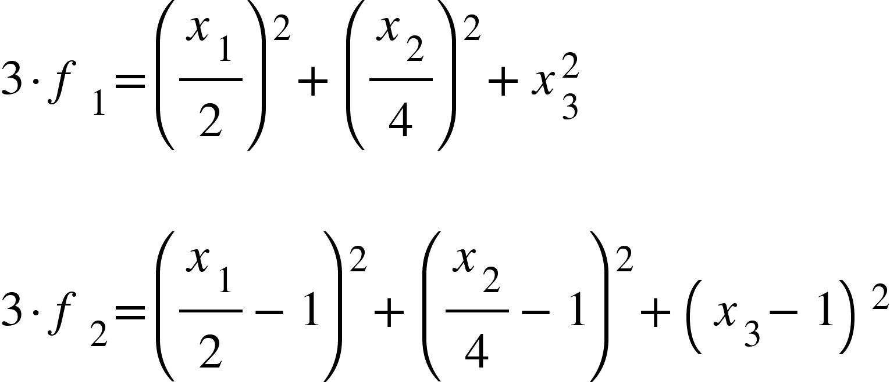
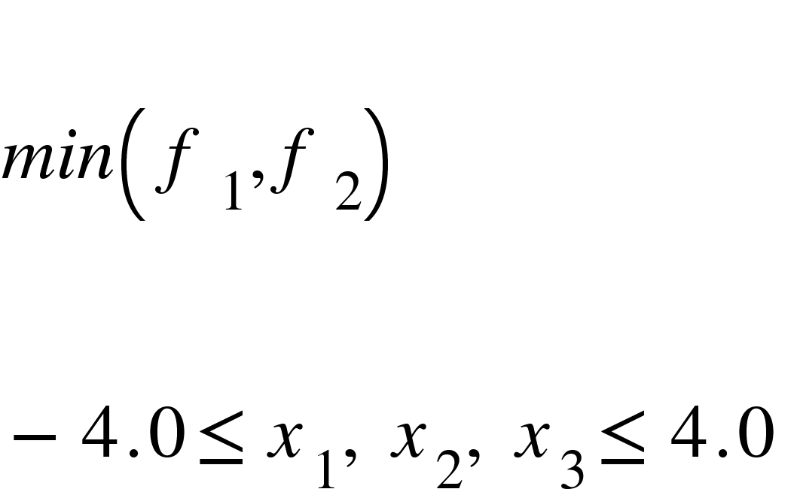
Functions

Slide 4
Genetic Algorithm
A genetic algorithm is a metaheuristic that is inspired by Charles Darwin’s theory of natural evolution. This algorithm reflects the process of natural selection where the fittest individuals are selected for reproduction in order to produce offspring of the next generation.
Genetic algorithms are commonly used to generate high-quality solutions to optimization and search problems

Slide 5
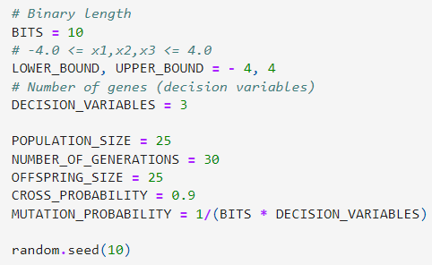
Initial Population
A set of individuals which is called a Population.
An individual is characterized by a set of parameters (variables) known as Genes.
Genes are joined into a string to form a Chromosome (solution). Binary values are used to represent the chromosome.

Slide 6
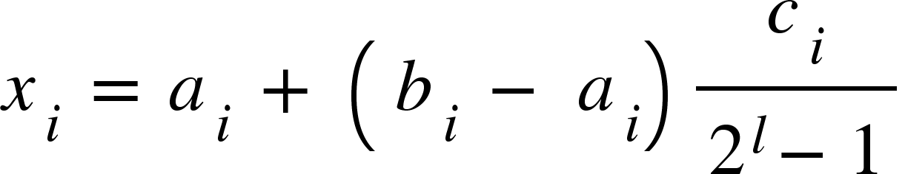
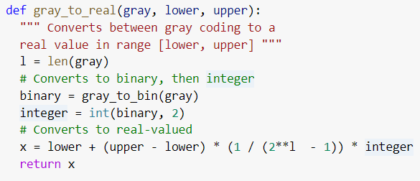
Gray Encoding
Gray Encoding is used to avoid the occurrences of Hamming Walls.
A Hamming wall is a point at which it becomes rare or highly unlikely that the GA will mutate in exactly the right way to produce the next step in fitness.
Due to the properties of Gray Coding, this is much less likely to happen.
Notes:
https://stackoverflow.com/questions/41245917/what-are-the-benefits-of-gray-code-in-evolutionary-computation

Slide 7
Fitness Function
Determines how fit an individual is, and gives a fitness score, it’s an ability of an individual to compete.
The probability that an individual will be selected for reproduction is based on its fitness score.

Slide 8
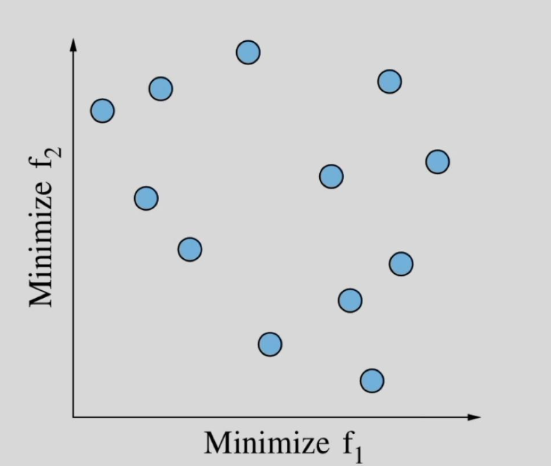
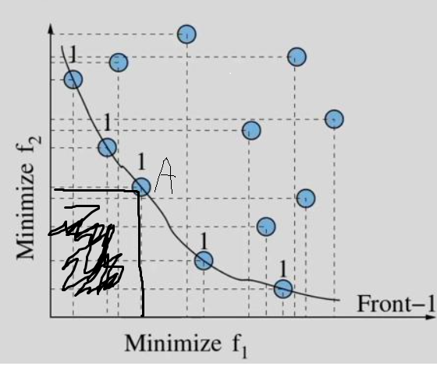
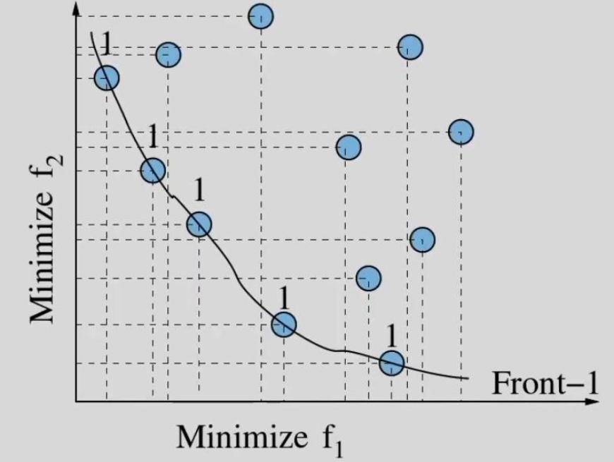
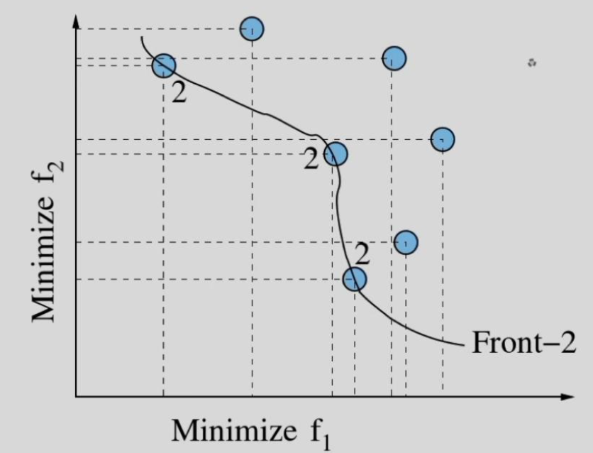
Selection
Selects the fittest individuals and let them pass their genes to the next generation.
Two pairs of individuals (parents) are selected based on their fitness scores.
Domination: An individual is said to dominate another
If the objective functions of it is no worse than the other.
At least in one of its objective functions it is better than the other.
First front is non-dominated, Second front being dominated by the individuals in the first front only and the formation of front goes on.
Notes:
Tournament selection provides selection pressure by holding a tournament among S competitors, with S being the tournament size. The winner of the tournament is the individual with the highest fitness of the S tournament competitors. The winner is then inserted into the mating pool. The mating pool, being comprised of tournament winners, has a higher average fitness than the average population fitness. T his fitness difference provides the selection pressure , which drives the GA to improve the fitness of each succeeding generation . Increased select ion pressure can be provided by simply increasing the tournament size s, as the winner from a larger tournament will, on average, have a higher fitness than the winner of a smaller tournament.

Slide 9
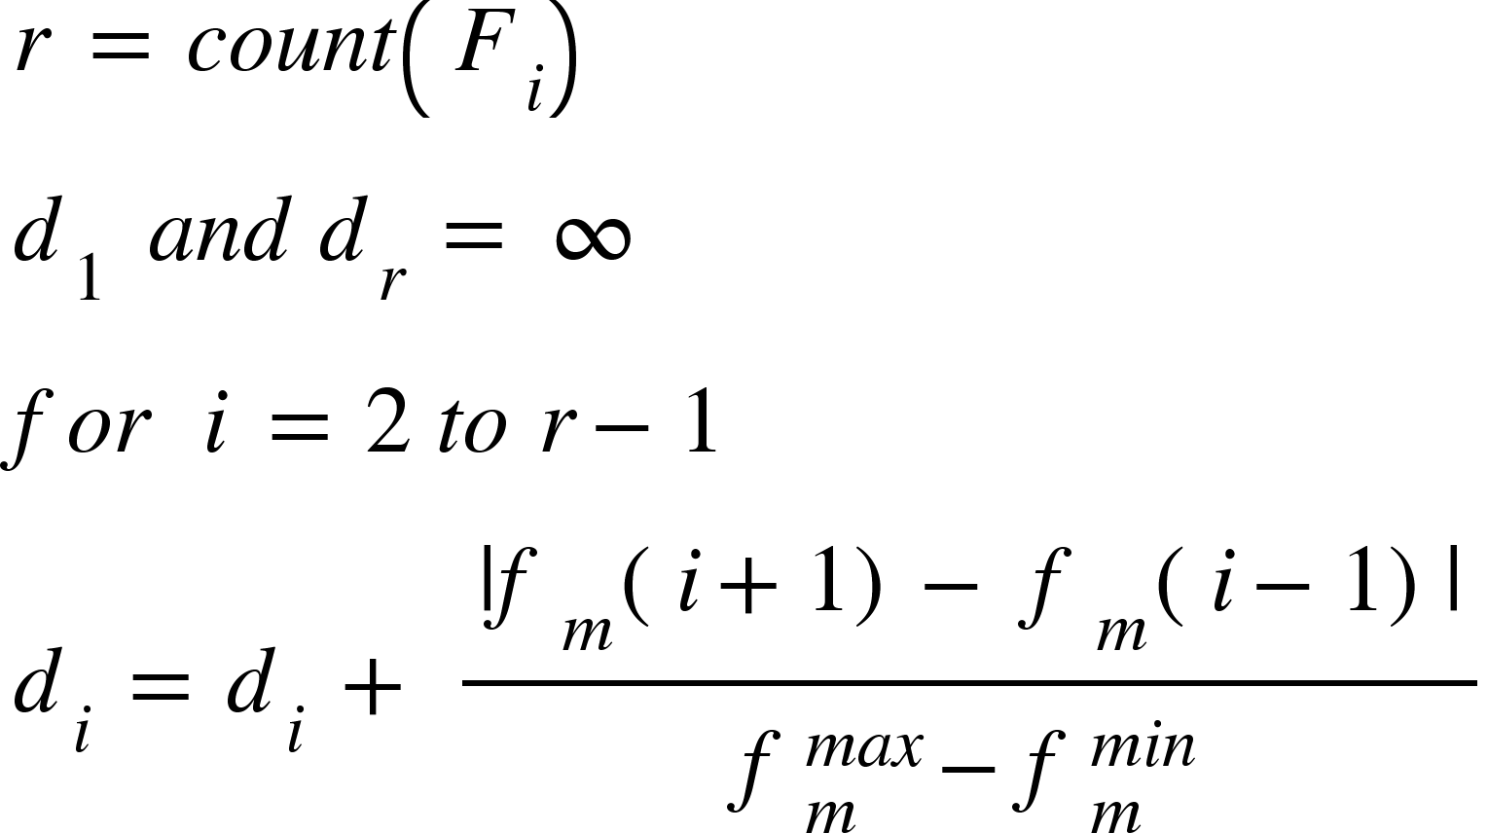
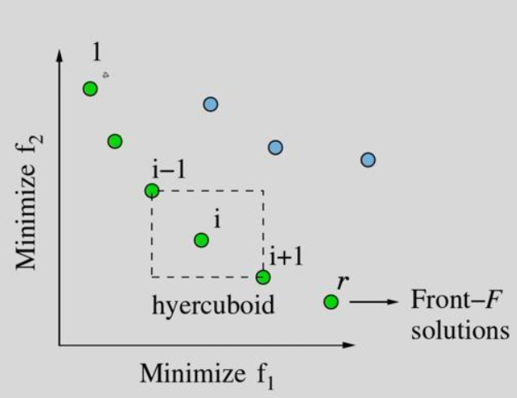
Selection
Crowding distance is the measure of how close an individual to its neighbour.
Larger the crowding distance, better the diversity in the population.
Fitness value and the Crowding distance is assigned to each individual in the Front.
The selection pressure is the degree to which the better individuals are favored, the higher the selection pressure, the more the better individuals are favored.
Notes:
Tournament selection provides selection pressure by holding a tournament among S competitors, with S being the tournament size. The winner of the tournament is the individual with the highest fitness of the S tournament competitors. The winner is then inserted into the mating pool. The mating pool, being comprised of tournament winners, has a higher average fitness than the average population fitness. T his fitness difference provides the selection pressure , which drives the GA to improve the fitness of each succeeding generation . Increased select ion pressure can be provided by simply increasing the tournament size s, as the winner from a larger tournament will, on average, have a higher fitness than the winner of a smaller tournament.

Slide 10
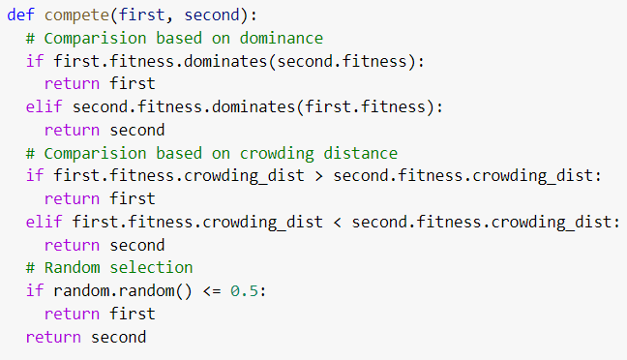
Selection
GAs are able to identify optimal or near-optimal solutions under a wide range of selection pressure
If the selection pressure is too low, the convergence rate will be slow, and the GA will unnecessarily take longer to find the optimal solution.
If the selection pressure is too high, there is an increased chance of the GA prematurely converging to an incorrect (suboptimal) solution.
Tournament selection provides selection pressure by holding a tournament among S competitors, with S being the tournament size.
Notes:
Tournament selection provides selection pressure by holding a tournament among S competitors, with S being the tournament size. The winner of the tournament is the individual with the highest fitness of the S tournament competitors. The winner is then inserted into the mating pool. The mating pool, being comprised of tournament winners, has a higher average fitness than the average population fitness. T his fitness difference provides the selection pressure , which drives the GA to improve the fitness of each succeeding generation . Increased select ion pressure can be provided by simply increasing the tournament size s, as the winner from a larger tournament will, on average, have a higher fitness than the winner of a smaller tournament.

Slide 11
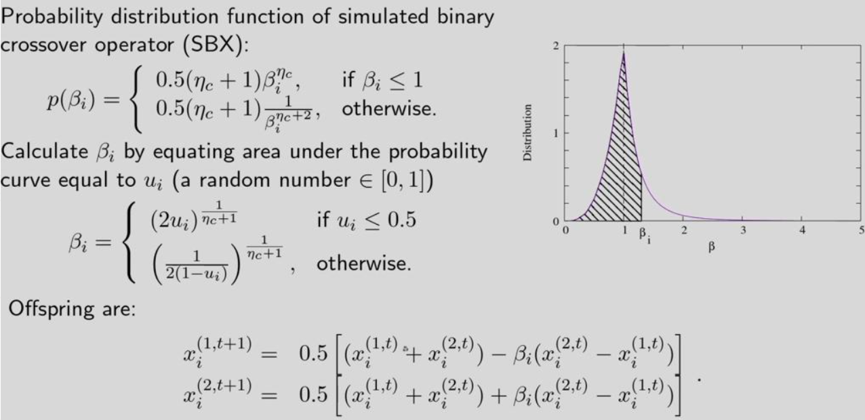
Crossover
For each pair of selected parents, a crossover point is chosen at random from within the genes.
Offsprings are created by exchanging the genes of parents among themselves until the crossover point is reached.
For example the two parents:
parent1 = 00000
parent2 = 11111
May result in two cross-over children:
child1 = 00011
child2 = 11100
Notes:
Individuals with high fitness have more chance to be selected for reproduction

Slide 12
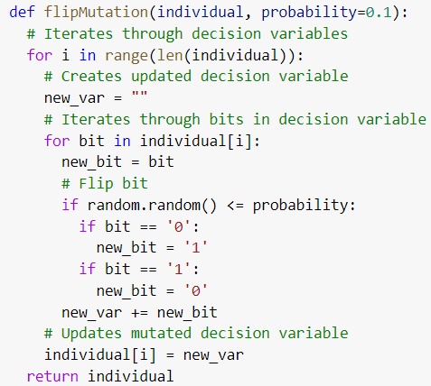
Mutation
Mutation occurs to maintain diversity within the population and prevent premature convergence.
In certain new offspring formed, some of their genes can be subjected to a mutation with a low random probability. This implies that some of the bits in the bit string can be flipped.
For example
Child = 000110011
Mutated Child = 000000011
Notes:
Individuals with high fitness have more chance to be selected for reproduction

Slide 13
Termination
The algorithm terminates if the population has converged (does not produce offspring which are significantly different from the previous generation).
Then it is said that the genetic algorithm has provided a set of solutions to our problem.

Slide 14
NSGA-II
Population Initialized.
Domination: An individual is said to dominate another
If the objective functions of it is no worse than the other.
At least in one of its objective functions it is better than the other.
First front is non-dominated, Second front being dominated by the individuals in the first front only and the formation of front goes on.
Crowding distance is the measure of how close an individual to its neighbour.
Larger the crowding distance, better the diversity in the population.
Crowding distance is compared if both the individuals have same rank.
Notes:
The whole process repeats till the optimal solution is achieved or till the desired number of generations are completed.

Slide 15
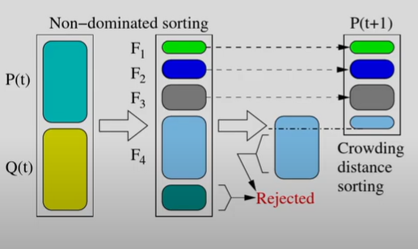
NSGA-II
Parents are selected by using binary tournament selection based on the rank and crowding distance.
Offsprings are generated from the crossover function and mutation operation is applied on the offsprings.
Notes:
The whole process repeats till the optimal solution is achieved or till the desired number of generations are completed.

Slide 16
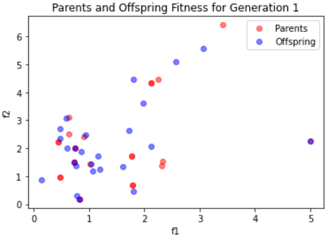
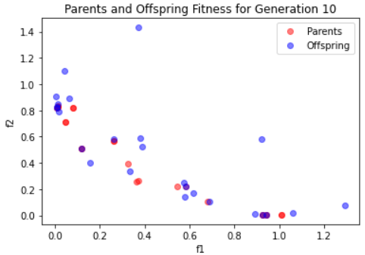
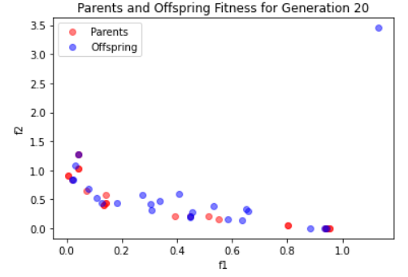
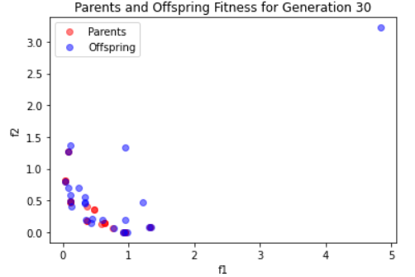
NSGA-II Results
Notes:
The whole process repeats till the optimal solution is achieved or till the desired number of generations are completed.

Slide 17
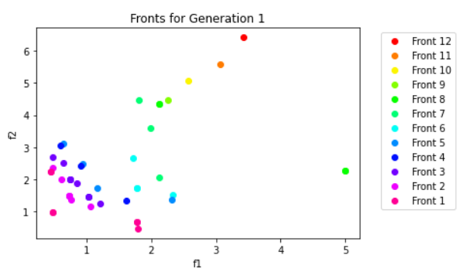
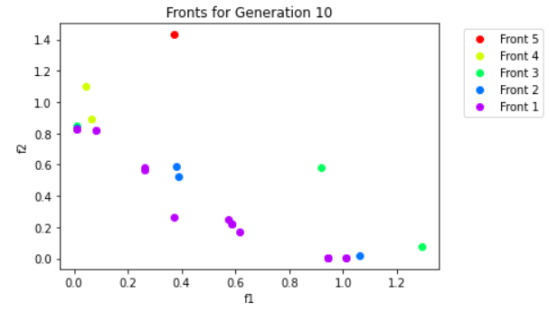
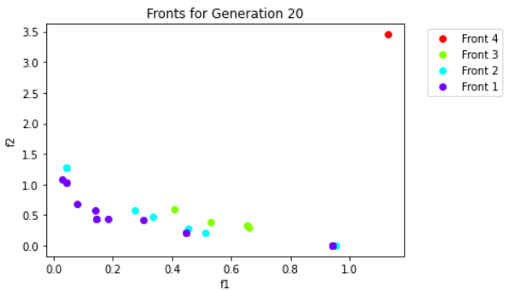
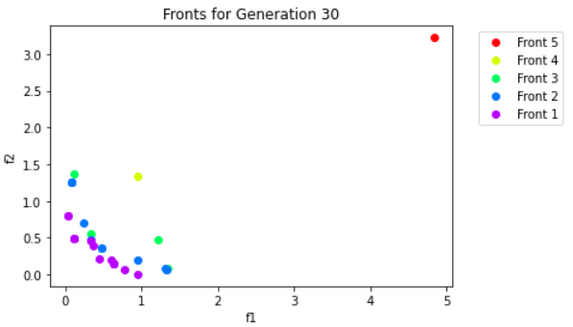
NSGA-II Results
Notes:
The whole process repeats till the optimal solution is achieved or till the desired number of generations are completed.

Slide 18
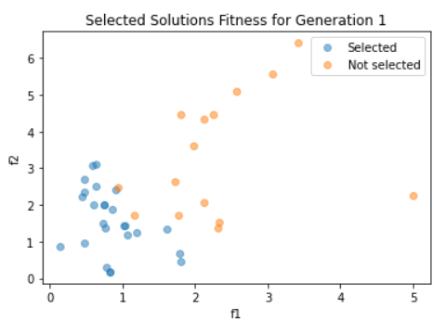
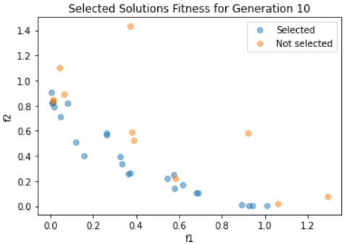
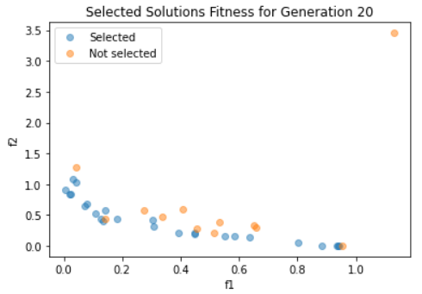
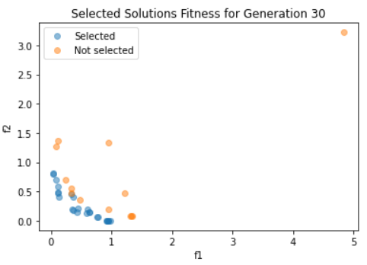
NSGA-II Results
Notes:
The whole process repeats till the optimal solution is achieved or till the desired number of generations are completed.

Slide 19
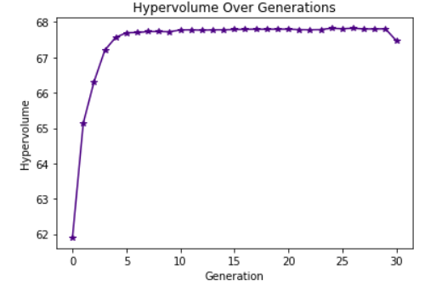
Hypervolume
The hypervolume indicator is a measure used to evaluate the performance of search algorithms and to guide the search.

Slide 20
Thank you

